Slide 1
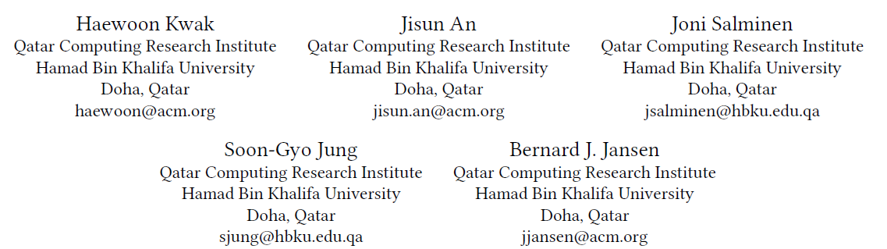
WhatWe Read, WhatWe Search: Media Attention and Public Attention Among 193 Countries

Slide 2
RQ1: How are media attention and public attention structurally
aligned?
RQ2: What is the causal relationship between media attention and public attention?
RQ3: Are there topical aspects that affect the interaction between media attention and public attention?

Slide 3
Building the multiplex network
build a multiplex network of attention among countries.
The attention has two types: media attention and public attention.
Each country is mapped into a node of the multiplex network
edge ：the attention from one country to another
Edge weight: the strength of the attention.
Notes:
前者由新闻报道捕获

Slide 4

Media Attention Layer
The weight of links from ci to cj is the number of news articles mentioning cj published by news media in ci .
eliminate self-loops, which represent domestic news.
The links discovered by the disparity filter are called the backbone of the network: B(・)
Notes:
考虑到各国媒体市场的不同规模，找到一个链接权重的全球阈值进行剪枝并非易事。

Slide 5
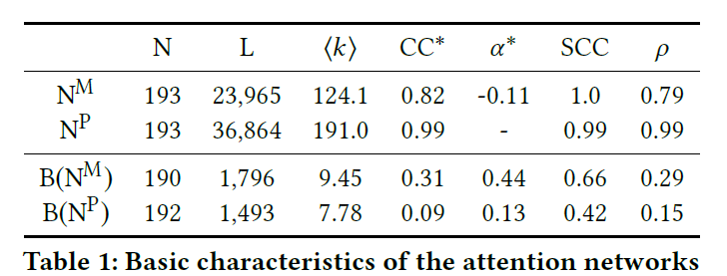
Basic Characteristics of the Attention Networks
the number of nodes N, that of links L, the mean degree ⟨k⟩, the average clustering coefficient CC, the assortativity coefficient α , the percentage of the strongest connected component SCC(%), and the reciprocity ρ

Slide 6

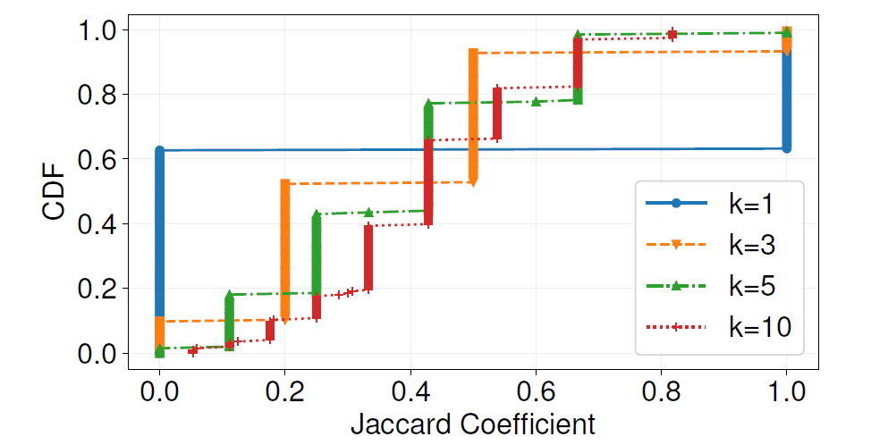
the structural characteristics of the media attention and the public attention
Centrality Correlations: compare the centrality of countries in the media attention network and the public attention network.
The Spearman correlation coefficients of the degree centrality, betweenness centrality, eigenvector centrality, and closeness centrality between
All of these positive coefficients show the moderate positive relationship between the two.
Overlap of Top@k Neighbor Countries
Notes:
如果一个国家得到了其他国家媒体的广泛关注，它是否也得到了公众的广泛关注
度中心性、中介中心性、特征向量中心性、封闭性中心性
媒体注意和公众注意的结构特征在二元水平上是不同的，这与节点中心的高相关性是相反的

Slide 7
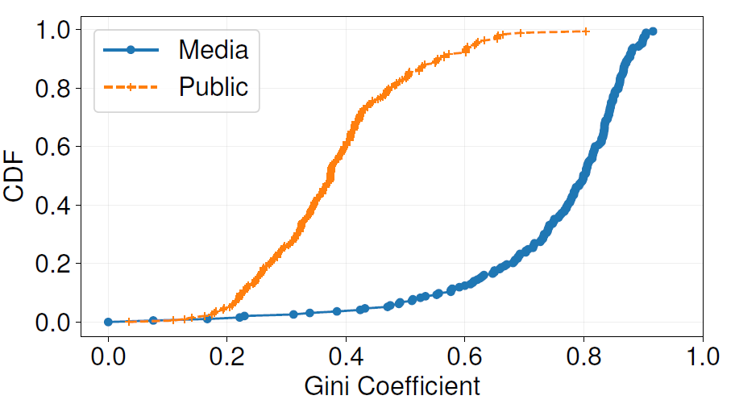
the distance and trade volume between countries do not differently influence the dyadic relationships
temporally stable
Attention Balance: compute the Gini coefficients of the link weights for each node
Notes:
一个国家的注意力有多少集中在top@k邻居身上?媒体和公众的注意力在多大程度上从一个国家转移到另一个国家?为了回答这个问题，我们计算每个节点的链接权值的基尼系数。
基尼系数衡量给定分布的统计离散度或不平等。基本上，系数越大，表示不平等或偏态分布越多。当给定的分布是均匀的(完全相等)时，最小值为零;当给定的分布是最大偏态时，最大值为1。
表示各节点链路权值的基尼系数在NM和NP中的累积分布
NP中基尼系数的累积分布位于NM中基尼系数的左侧。这表明公众对其他国家的关注比媒体的关注更加平等。NP和NM的基尼系数中值分别为0.374和0.799。我们确认了差异

Slide 8
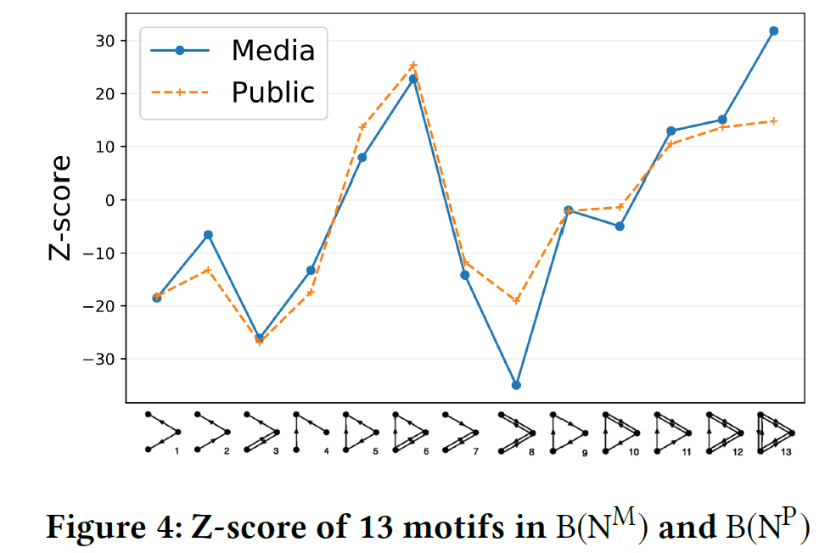
Attention Flow among Three Countries
A positive (negative) Z-score means that the corresponding motif is overrepresented (underrepresented) as compared to the null model, which is an ensemble of the 1,000 random networks with the same degree distribution.

Slide 9
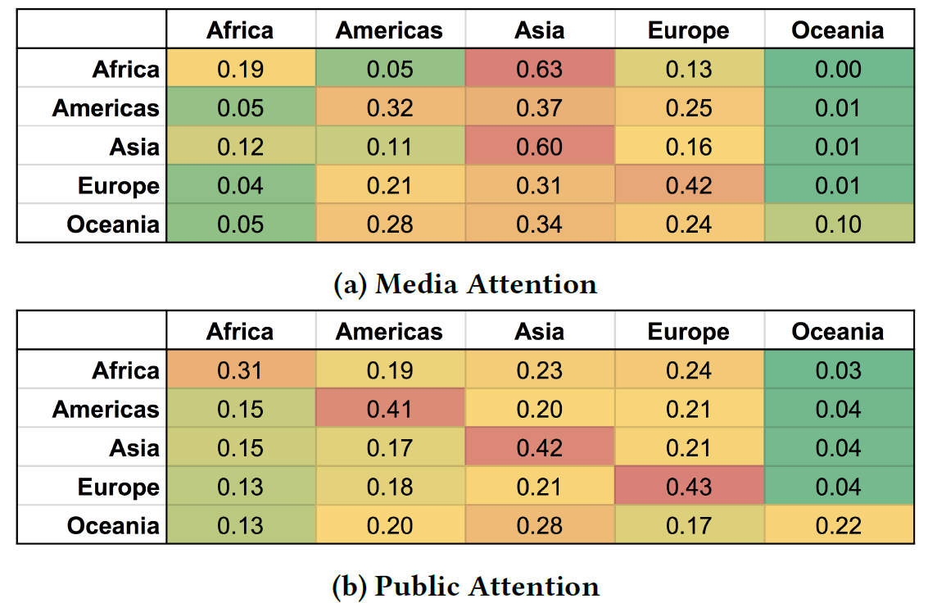
Attention Flow among Regions
add geographical information as the node properties to the network to extract meaningful patterns from the attention flow.
Notes:
在媒体关注度方面，亚洲和欧洲对自身关注度最高，其他地区次之。相比之下，在公众关注方面，除大洋洲外，其他地区都是最关注自己的。其次，亚洲作为媒体关注的接受者的出现是显而易见的，而这在公众的关注中是不可见的。除欧洲外，其他地区对亚洲的关注程度最高，甚至欧洲也是第二高的。最后，公众的关注比媒体更加平等。

Slide 10
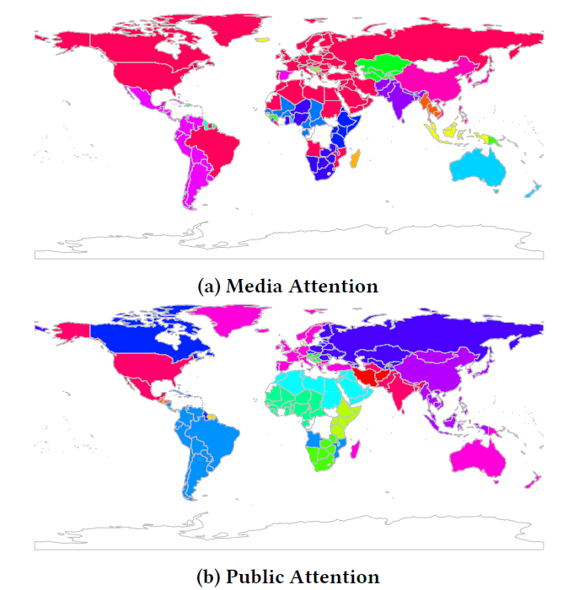
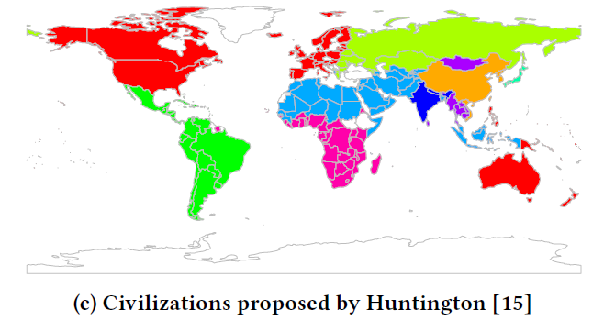
Community Structure in Networks
find groups of countries based on the actual attention flow by a community identification method
community identification method: use InfoMAP based on a random walk that can incorporate the direction of the links by nature.
Notes:
由此产生的群体可以揭示出媒体关注和公众关注网络的嵌入式模块化结构
在B(NM)，有一个巨大的社区
共享文化和宗教身份的“文明”对于理解冷战后世界的冲突非常重要。

Slide 11
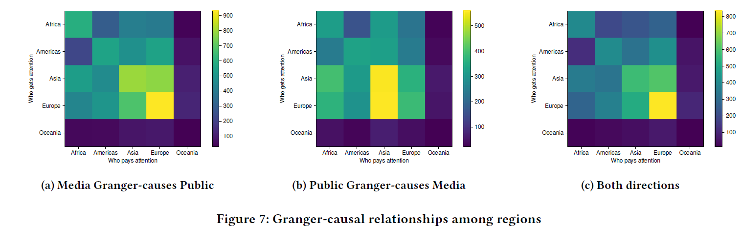
Interplay between media attention and public attention
Granger causality is a statistical concept of causality between two time series.
Notes:
简单来说它通过比较“已知上一时刻所有信息，这一时刻X的概率分布情况”和“已知上一时刻除Y以外的所有信息，这一时刻X的概率分布情况”，来判断Y对X是否存在因果关系。
当媒体关注同一地区的一个国家时，媒体关注和公众关注之间的联系比其他地区更强。

Slide 12
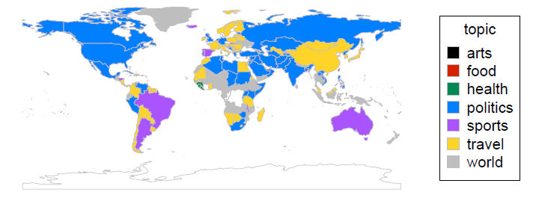
Topic-level Interaction
topics of co-mentions for each country

